Slide 1
How to Apply for Allocations
Will Wrobel
Sofia Melhor
Gabriel Owusu

Slide 2
Submission Timing
Must be submitted at least 15 business days before the date of the event
Ex. For an event on October 25th, 2019, the last day to submit a request is October 7th, 2019
Honoraria require at least 30 business days
As long as the original request was submitted at least 15 business days prior, all resubmissions can be submitted within those 15 business days
Keep in mind that the closer the resubmissions are to the event date, the less likely it is that the items will arrive in time for the event

Slide 3
Reimbursements
Reimbursements will not be approved
Exception to this rule is for any event occurring prior to September 6th, 2019

Slide 4
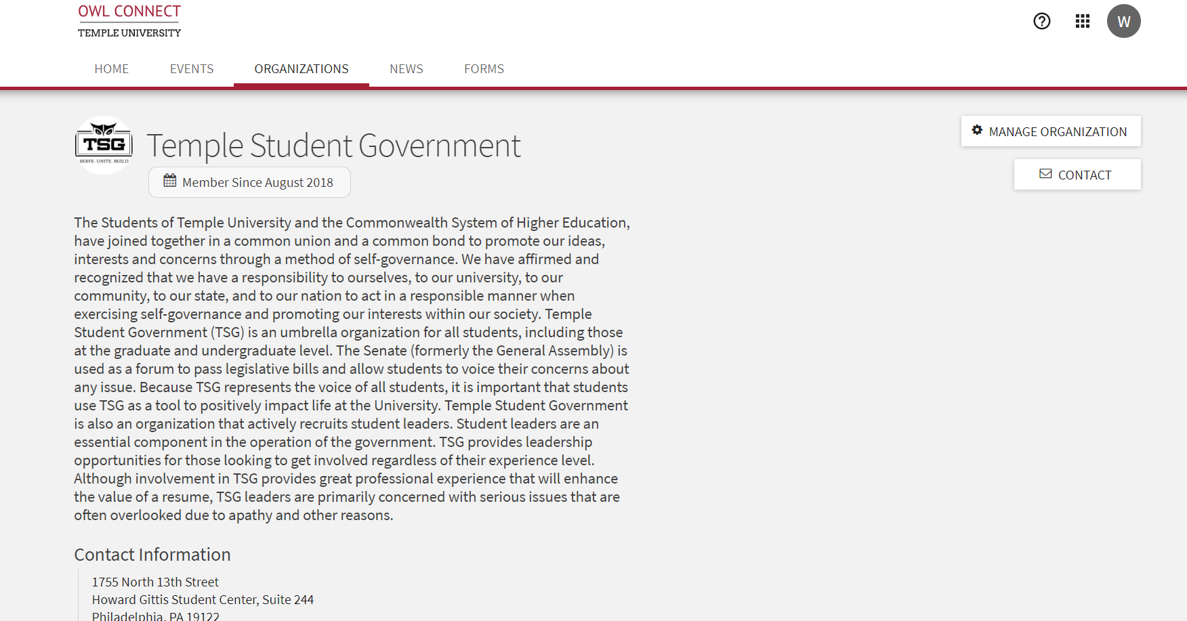
Finding the Form
**Only officers who are listed in the organizations Owl Connect roster have access to apply

Slide 5
Finding the Form

Slide 6
Finding the Form

Slide 7
Finding the Form

Slide 8
DO NOT SELECT “Create Funding Request”

Slide 9
Request Details

Slide 10
Request Details
Subject: Title of the Event
If operating budget, set subject as “[org name] operating budget”
Description: Detailed description that answers…
What is the event?
Why are you holding it?
What the event brings to your organization?
Other details that help the Committee better understand the event
Request Amount: Amount of Allocations you wish to receive
Categories: Select “TSG Allocations – (Main Campus Groups Only)”
Account: Your organizations account name

Slide 11
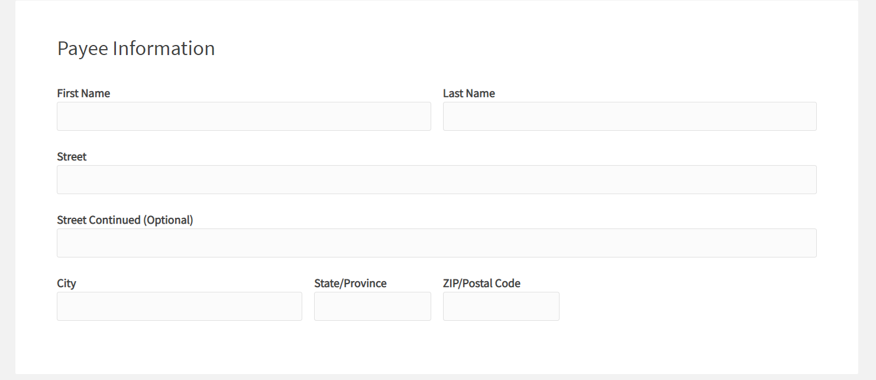
Payee Information
**LEAVE THIS INFORMATION BLANK**

Slide 12
Additional Information

Slide 13
Additional Information
STARS/DIAMOND Status
Date and Time of Event
Ensure event date is at least 15 business days away
Program Location
Resubmission?
What is the reason for the resubmission
Annual Program?
Event opening: Indicate the total attendance for the event
Admission fee: Provide your admission fee
If you have already calculated your estimated sales revenue, put that figure here

Slide 14
Expenses and Payee Information

Slide 15
Main Campus Purchase Request Spreadsheet
>File
>Download as
Microsoft Excel

Slide 16
Main Campus Purchase Request Spreadsheet

Slide 17
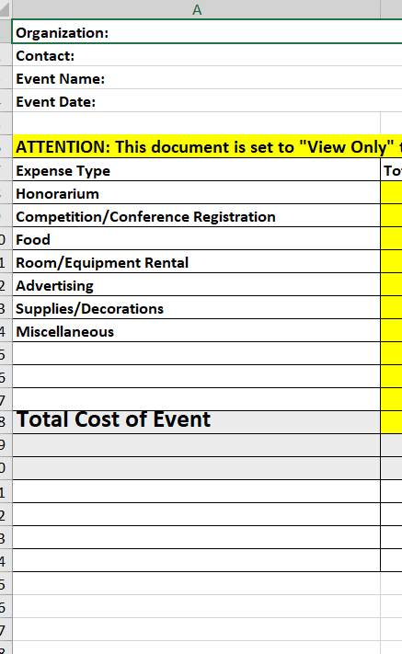
Program Expenses Sheet
Row A outlines each type of expense
Honorarium = Guest Speaker, performer, etc.
DO NOT change the formatting of the document
DO NOT create additional rows or columns
List all expenses not given a category in the “Miscellaneous” row

Slide 18
Program Expenses Sheet
Row B outlines the total cost of each type of expense, regardless of whether Allocations is covering it
Current figures are in there for example purposes, you can delete them

Slide 19
Program Expenses Sheet
Row C is for indicating how much of each expense type you would like Allocations to cover
For example, if your event has $1000 in food expenses, but you would like Allocations to only cover $500 of it, in row B, you would input $1000 and in row C you would input $500
In the row 18 you will indicate the total costs
Cell B18 will indicate the total cost of the event
Cell C18 will indicate the total amount you wish Allocations to cover

Slide 20
Itemized Purchases
This sheet does not need to be used for honorariums, room rentals, and other non-itemized expenses
Vendor
Quantity
Unit Price
Total Price: Please use and Excel formula to calculate
For example, in cell D2, type “=B2*C2” to find the total price of an item in row 2
Item Name
URL Link

Slide 21
Itemized Expenses
Purpose of Item: briefly describe why you need the particular item
Additional Information
**Items that have already been added are for example purposes, please delete when you complete the form**

Slide 22
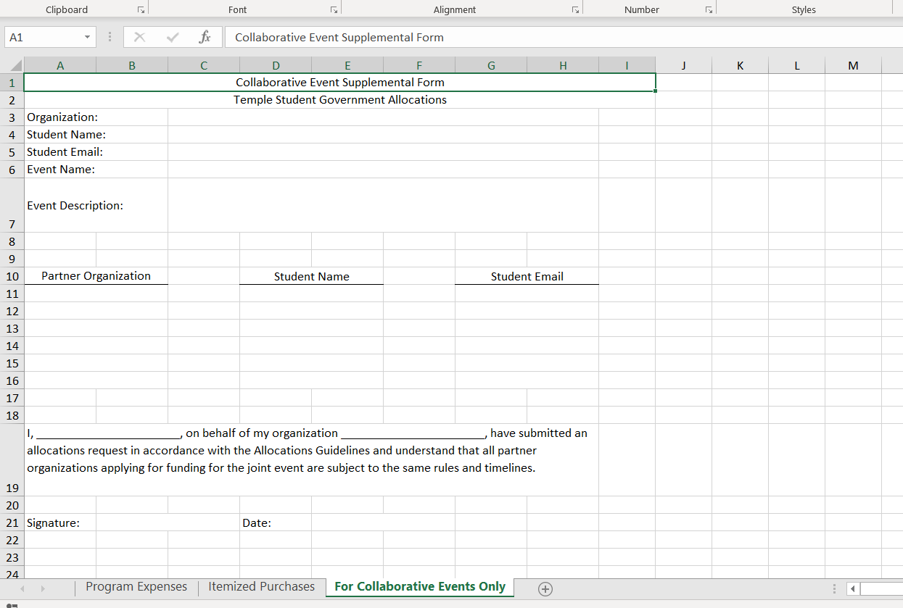
Collaborative Events Only Sheet
Only fill out this sheet if you are hosting a collaborative event with another organization
If you would like to have a collaborative event to split the costs of the event, please consult one of the Directors to find out how to properly fill out a request

Slide 23
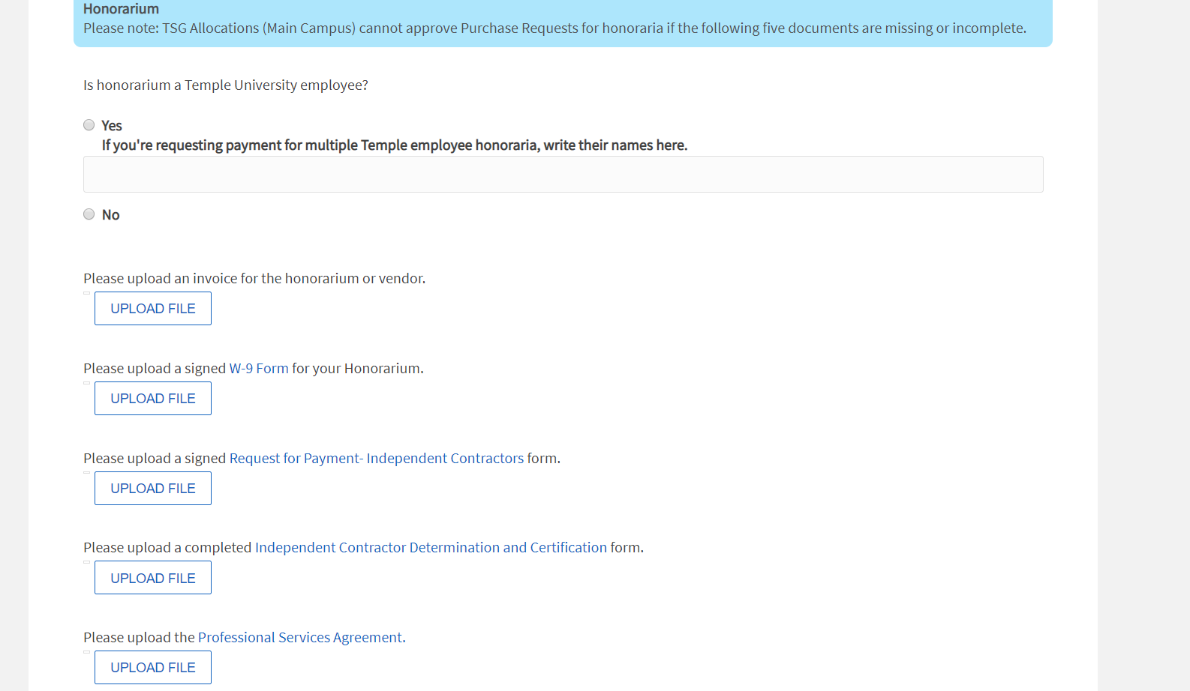
Supporting Documentation: Honorarium
Used to honorarium supporting documentation
Links to 4 of the documents are in their respective upload spot
Upload these documents as PDFs

Slide 24
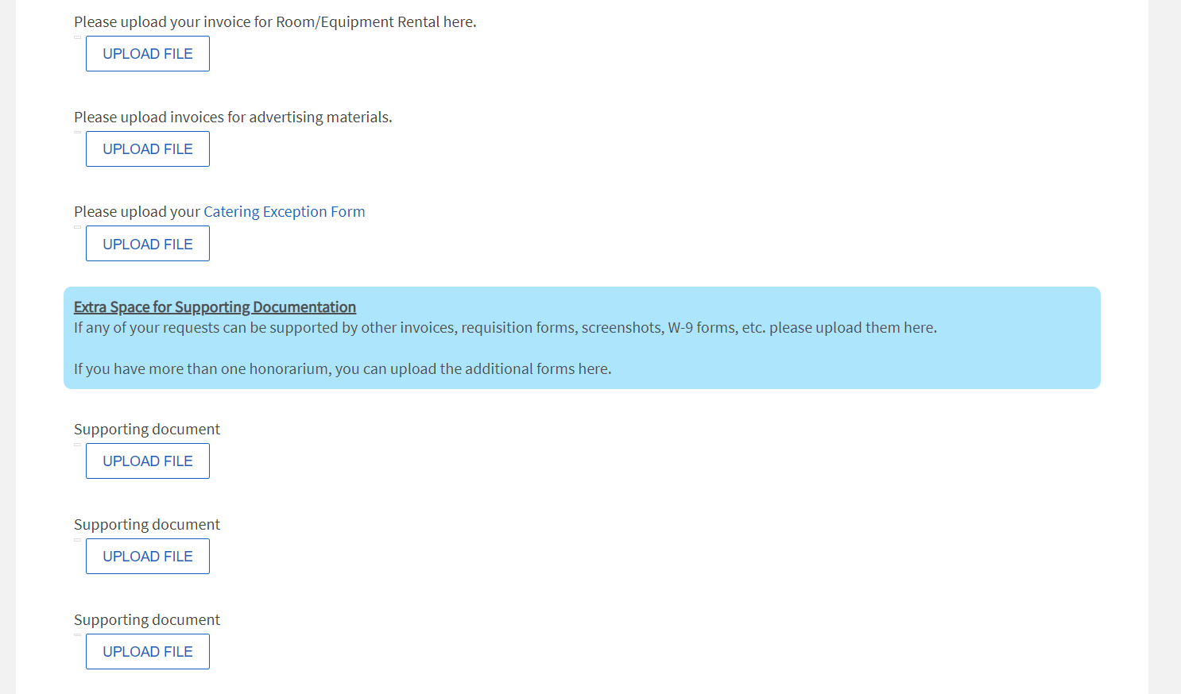
Supporting Documentation: Other
There are other upload spots for Room rental invoices, advertising invoices, and the Catering Exception form (linked)
If there are other documents that do not fit the previous upload spots, you can place them in extra space upload spots
If you are requesting funds for more than 1 honorarium, you can upload each of their 5 documents in these spots

Slide 25
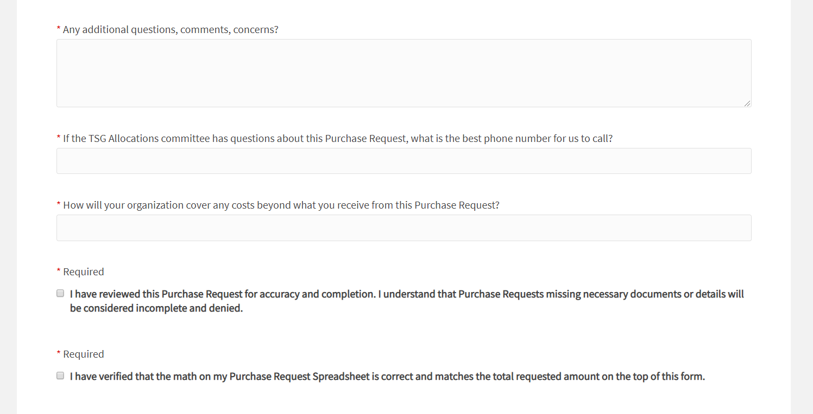
Final Inputs
Additional comments and concerns can be placed here. You can also email tsgabc@temple.edu if you would like a quicker response
If you leave a phone number, the Allocations Committee may give you a call during our weekly meeting if we have a pressing concern. The Committee meets every Friday at 4 pm

Slide 26
Post-Submission Information
Deputy Director conducts preliminary reviews of requests as they come in during the week
If your request is denied, you will receive a notification from Owl Connect with comments as to why it was denied. If missing documentation, you will be given steps on how to resubmit.
If your request has passed preliminary review, its stage will change from “Preliminary Review” to “Student Government – Main Campus”
Please note that requests still being reviewed will be marked “Unapproved.” If you request was denied, it will be marked “Denied” and if approved, it will be marked “Approved”
Each Friday at 4 pm, the Allocations Committee will conduct the final review of the request to check its adherence to the Guidelines
Denied requests will again be marked as denied and you will receive a notification from Owl Connect just like in preliminary review.

Slide 27
Post Submission Information
If approved, you will receive a notification from Owl Connect with instructions on the next steps
After approval, you have 4 business days to visit Ms. Chris in the HGSC Room 219M to complete your request
Once there, you will work together to get all vendors paid
If you do not visit Ms. Chris within those 4 business days, your request will be canceled, you will not be eligible to receive those items requested, and the approved amount will go back into your Owl Connect account.

Slide 28
Allocations Storage
There may be certain items that Allocations already owns, or would like to have returned for future use. These items will be held in the Allocations Storage
If the Committee would like for you to return an item, you will be given a form that must be completed within 5 business days after approval
Any items being borrowed can be picked up and returned in the TSG Office (HGSC Room 244). Please fill out the sheet on the front desk to let us know you stopped by.
All items must be returned within 5 business days after the event
Your org will become ineligible for Allocations if the 5 business days have passed and you still have outstanding items
Your organization can once again become eligible after the items are returned

Slide 29
Common Types of Requests: Supplies
If your request includes purchasing supplies, the only documentation we require is that you fill out the “Itemized Purchases” sheet of the Main Campus Purchase Request Spreadsheet
You DO NOT need to upload screenshots of the items
Please ensure that you have filled out all pricing information, correct URL link, and the purpose of the item

Slide 30
Common Types of Requests: Food
Food can be purchased from two sources
Cherry and White (Aramark)
The only documentation needed for food purchased from C&W is the catering quote provided by C&W. You can upload this document anywhere in the Supporting Documents section (example on next slide)
An Outside Vendor
First document: an itemized invoice indicating the items being ordered and the total price of the items
For restaurants provide an official invoice
For grocery stores and pizza places, you can list the items in the “Itemized Purchases Sheet” or provide a screenshot from an online order.
Second document: a Catering Exception Form
This document is linked in the Purchase Request. Please fill it out and have it signed by Business Services. Please upload it as a PDF

Slide 31
Cherry & White Quote Example

Slide 32
Common Types of Requests: Room Rental
If the room rental is at Temple, all that needs to be provided is the planning meeting form you completed with Student Activities
Please upload as a PDF
If the room rental is at an outside location, provide an invoice for the rental

Slide 33
Common Types of Request: Honorarium
Complete and upload the 4 honorarium documents which are linked in the Purchase Request
If there are concerns about these forms, ensure them that they are being processed through Owl Connects secure servers
Also have the Honorarium provide an official invoice that can show us their mailing information, the services provided, date of services, and total cost of services

Slide 34
Common Types of Requests: Conferences
Indicate in the request how many students will be attending the conference
Also provide a URL link to the conference registration website and indicate which registration package you would like to purchase
If the registration requires a login, please provide a screenshot of the registration cost and upload as a PDF

Slide 35
Final Thoughts
Even if you are not buying supplies, you still must fill out the Program Expenses sheet of the excel document to outline all of your events costs.
If you are having trouble with filling out the request, please email tsgabc@temple.edu or stop by our office hours and we will be happy to assist you.
If possible, please try to plan your events well in advance and come into our office hours to discuss
This way we can outline exactly what you will need to provide us and we can be aware of any complications.

